Slide 1
Analyzing Wearable Sensor Data for Occupational
Risk Analysis
By Clayton Wiley, Dylan Thornburg, and Zack Boyle

Slide 2
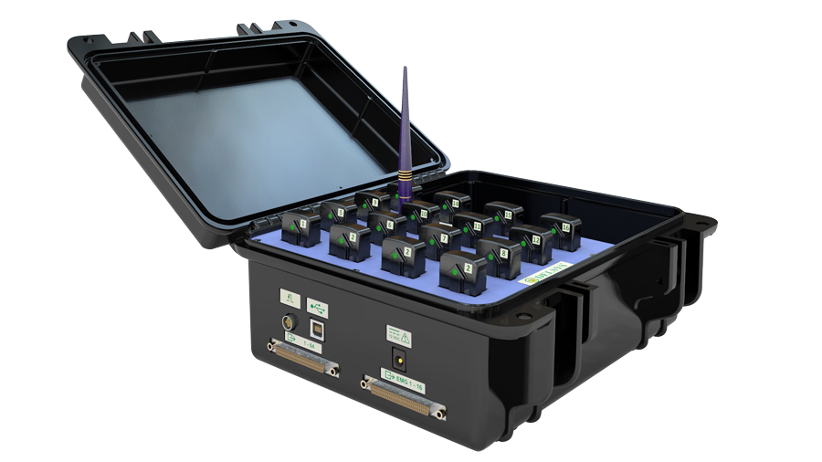
Intro
Use EMG sensors to observe strain on muscles during lifting
Sensors on deltoids & biceps
Use Logistic Regression, Decision Tree, and K-Nearest Neighbors models to classify lifts

Slide 3
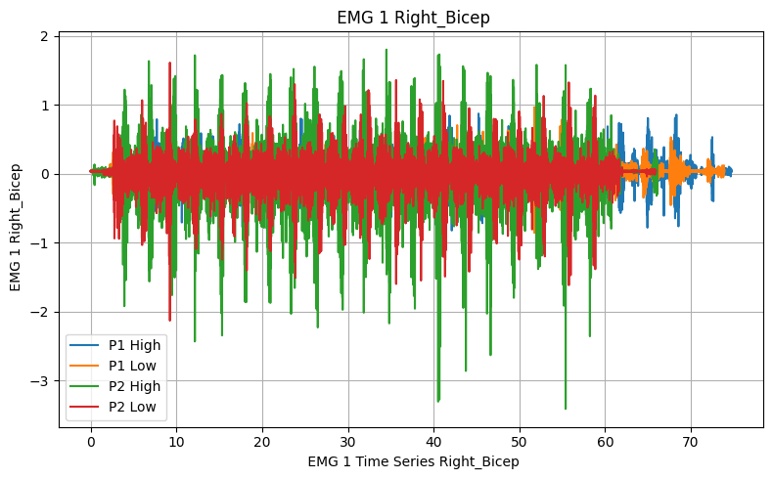
Data Understanding
2 participants
2-state independent variable
Time series data
4 Sensors
Electromyography meter
Gyroscope
Accelerometer
20 repetitions
4-second intervals

Slide 4
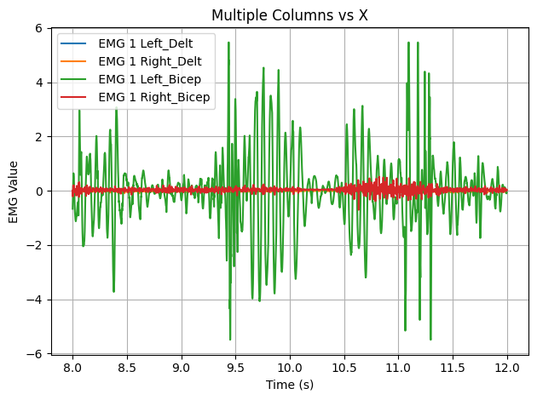
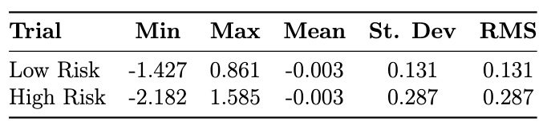
Preprocessing
Remove unused sensor data
Remove redundant time columns
Organize data 4-second intervals
Feature engineering
Hypotheses

Slide 5
Model Selection
Classify our data with three different models, see which one scores the best
Did not use Naive Bayes because it is predicated on independent features
Did not use Random Forest because our dataset was not large enough

Slide 6

Evaluation Metrics
Models scored with F1-score
We want our models to have the lowest amount of false positive and false negatives as possible

Slide 7
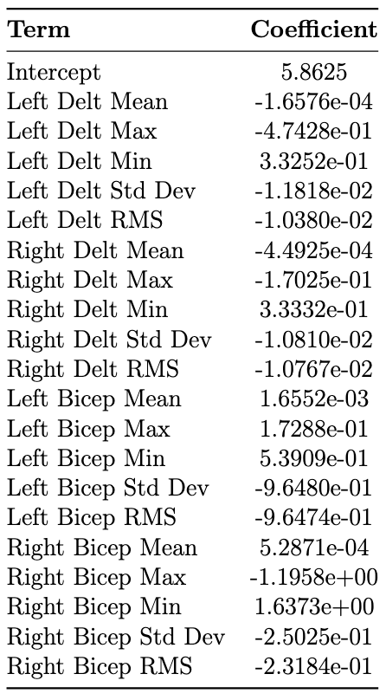
Logistic Regression
Training
Patterns:
Means tend to be 0
Mins tend to be similar to maxes

Slide 8
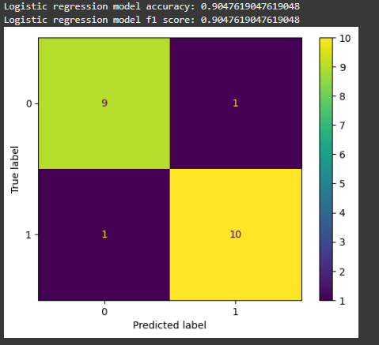
Logistic Regression Results
1 false positives
1 false negatives
90% accuracy is pretty good

Slide 9
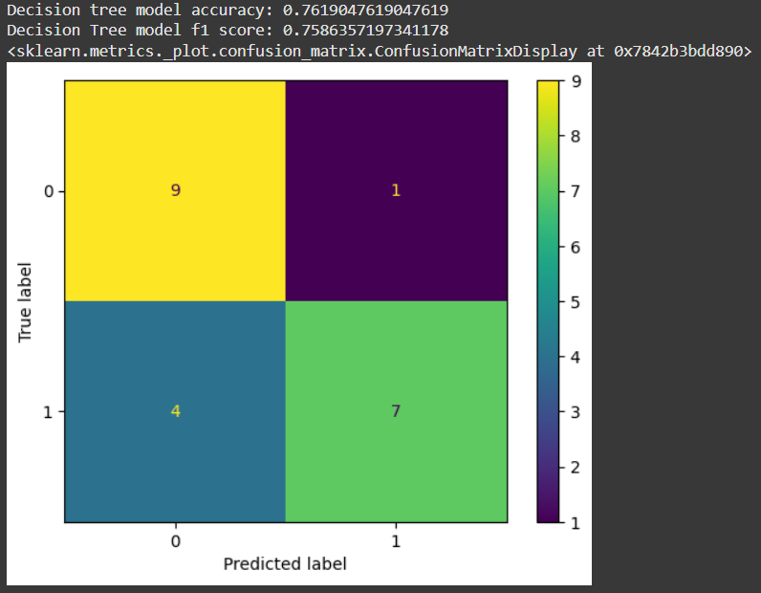
Decision Tree Results
Only one false positive
Four false negatives
76% is quite bad, and so is an f1 of 75.9%

Slide 10
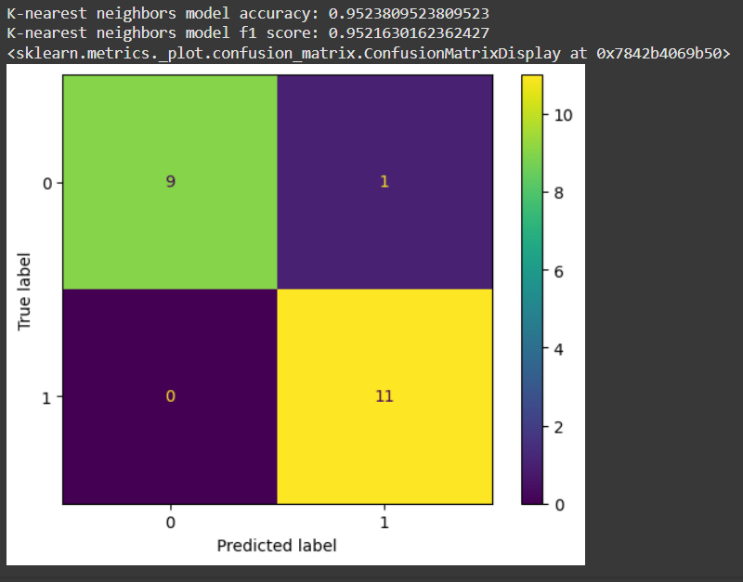
K-Nearest Neighbor Results
Only one false positive
No false negatives
The most accurate model at 95%

Slide 11
Discussing The Results
Logistic Regression struggled with nonlinear EMG patterns
Decision Tree likely overfit due to small dataset size
KNN worked well with clustered, non-linear features
Performance influenced by
Small sample size
Features such as mean, RMS, min, max, standard deviation
KNN was best, but not flawless & future data could change outcomes

Slide 12
Conclusions
KNN was the most accurate model
What we’d change if we did this experiment again:
Use a larger dataset to reduce overfitting and make more complex models, such as decision trees, viable
Try using a convolutional neural network (CNN) as they’re what’s typically used for image and signal data which means they could be effective for classifying EMG data

Slide 13
References
A. S. M. Miah, N. Hassan, Md. Maniruzzaman, N. Asai, and J. Shin, “EMG based hand gesture recognition through diverse domain feature enhancement and machine learning-based approach,” arXiv.org, https://arxiv.org/abs/2408.13723
GeeksforGeeks, “Overfitting in Decision Tree Models,” GeeksforGeeks, May 02, 2024. https://www.geeksforgeeks.org/overfitting-in-decision-tree-models/
OpenAI, “ChatGPT,” ChatGPT, Nov. 30, 2022. https://chatgpt.com/
scikit-learn, “sklearn.neighbors.KNeighborsClassifier — scikit-learn 0.22.1 documentation,” Scikit-learn.org, 2019. https://scikit-learn.org/stable/modules/generated/sklearn.neighbors.KNeighborsClassifier.html

